Slide 1
The Direction of Disaster

Slide 3
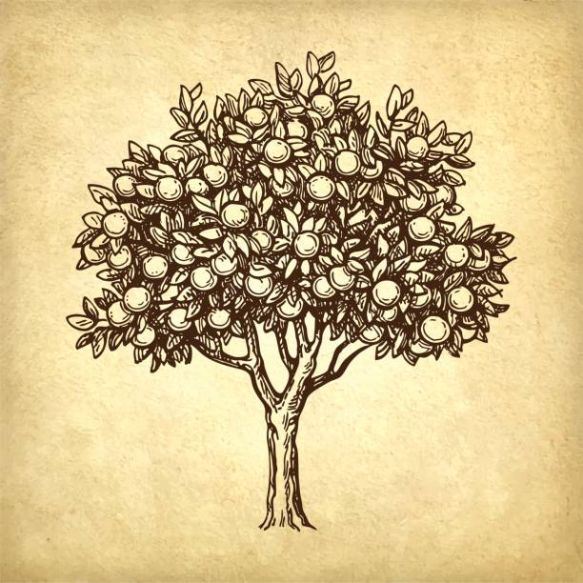
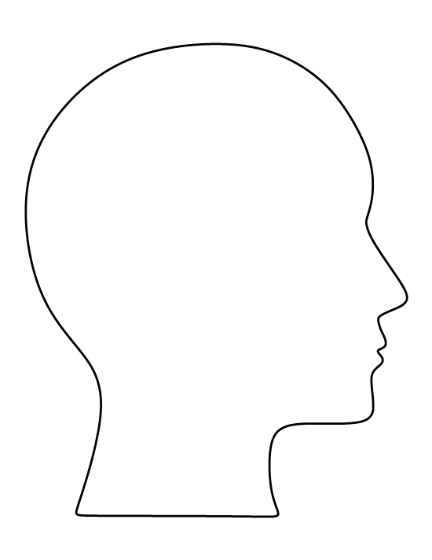
I don’t want to climb that…

Slide 4
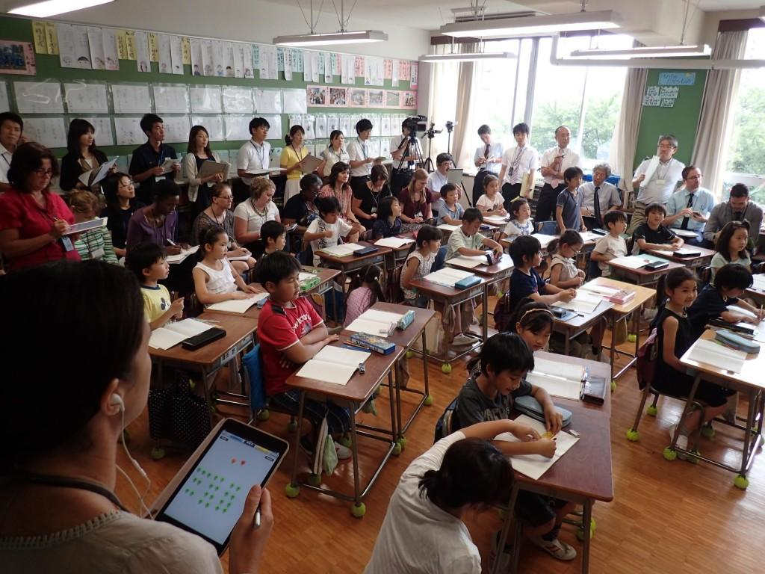
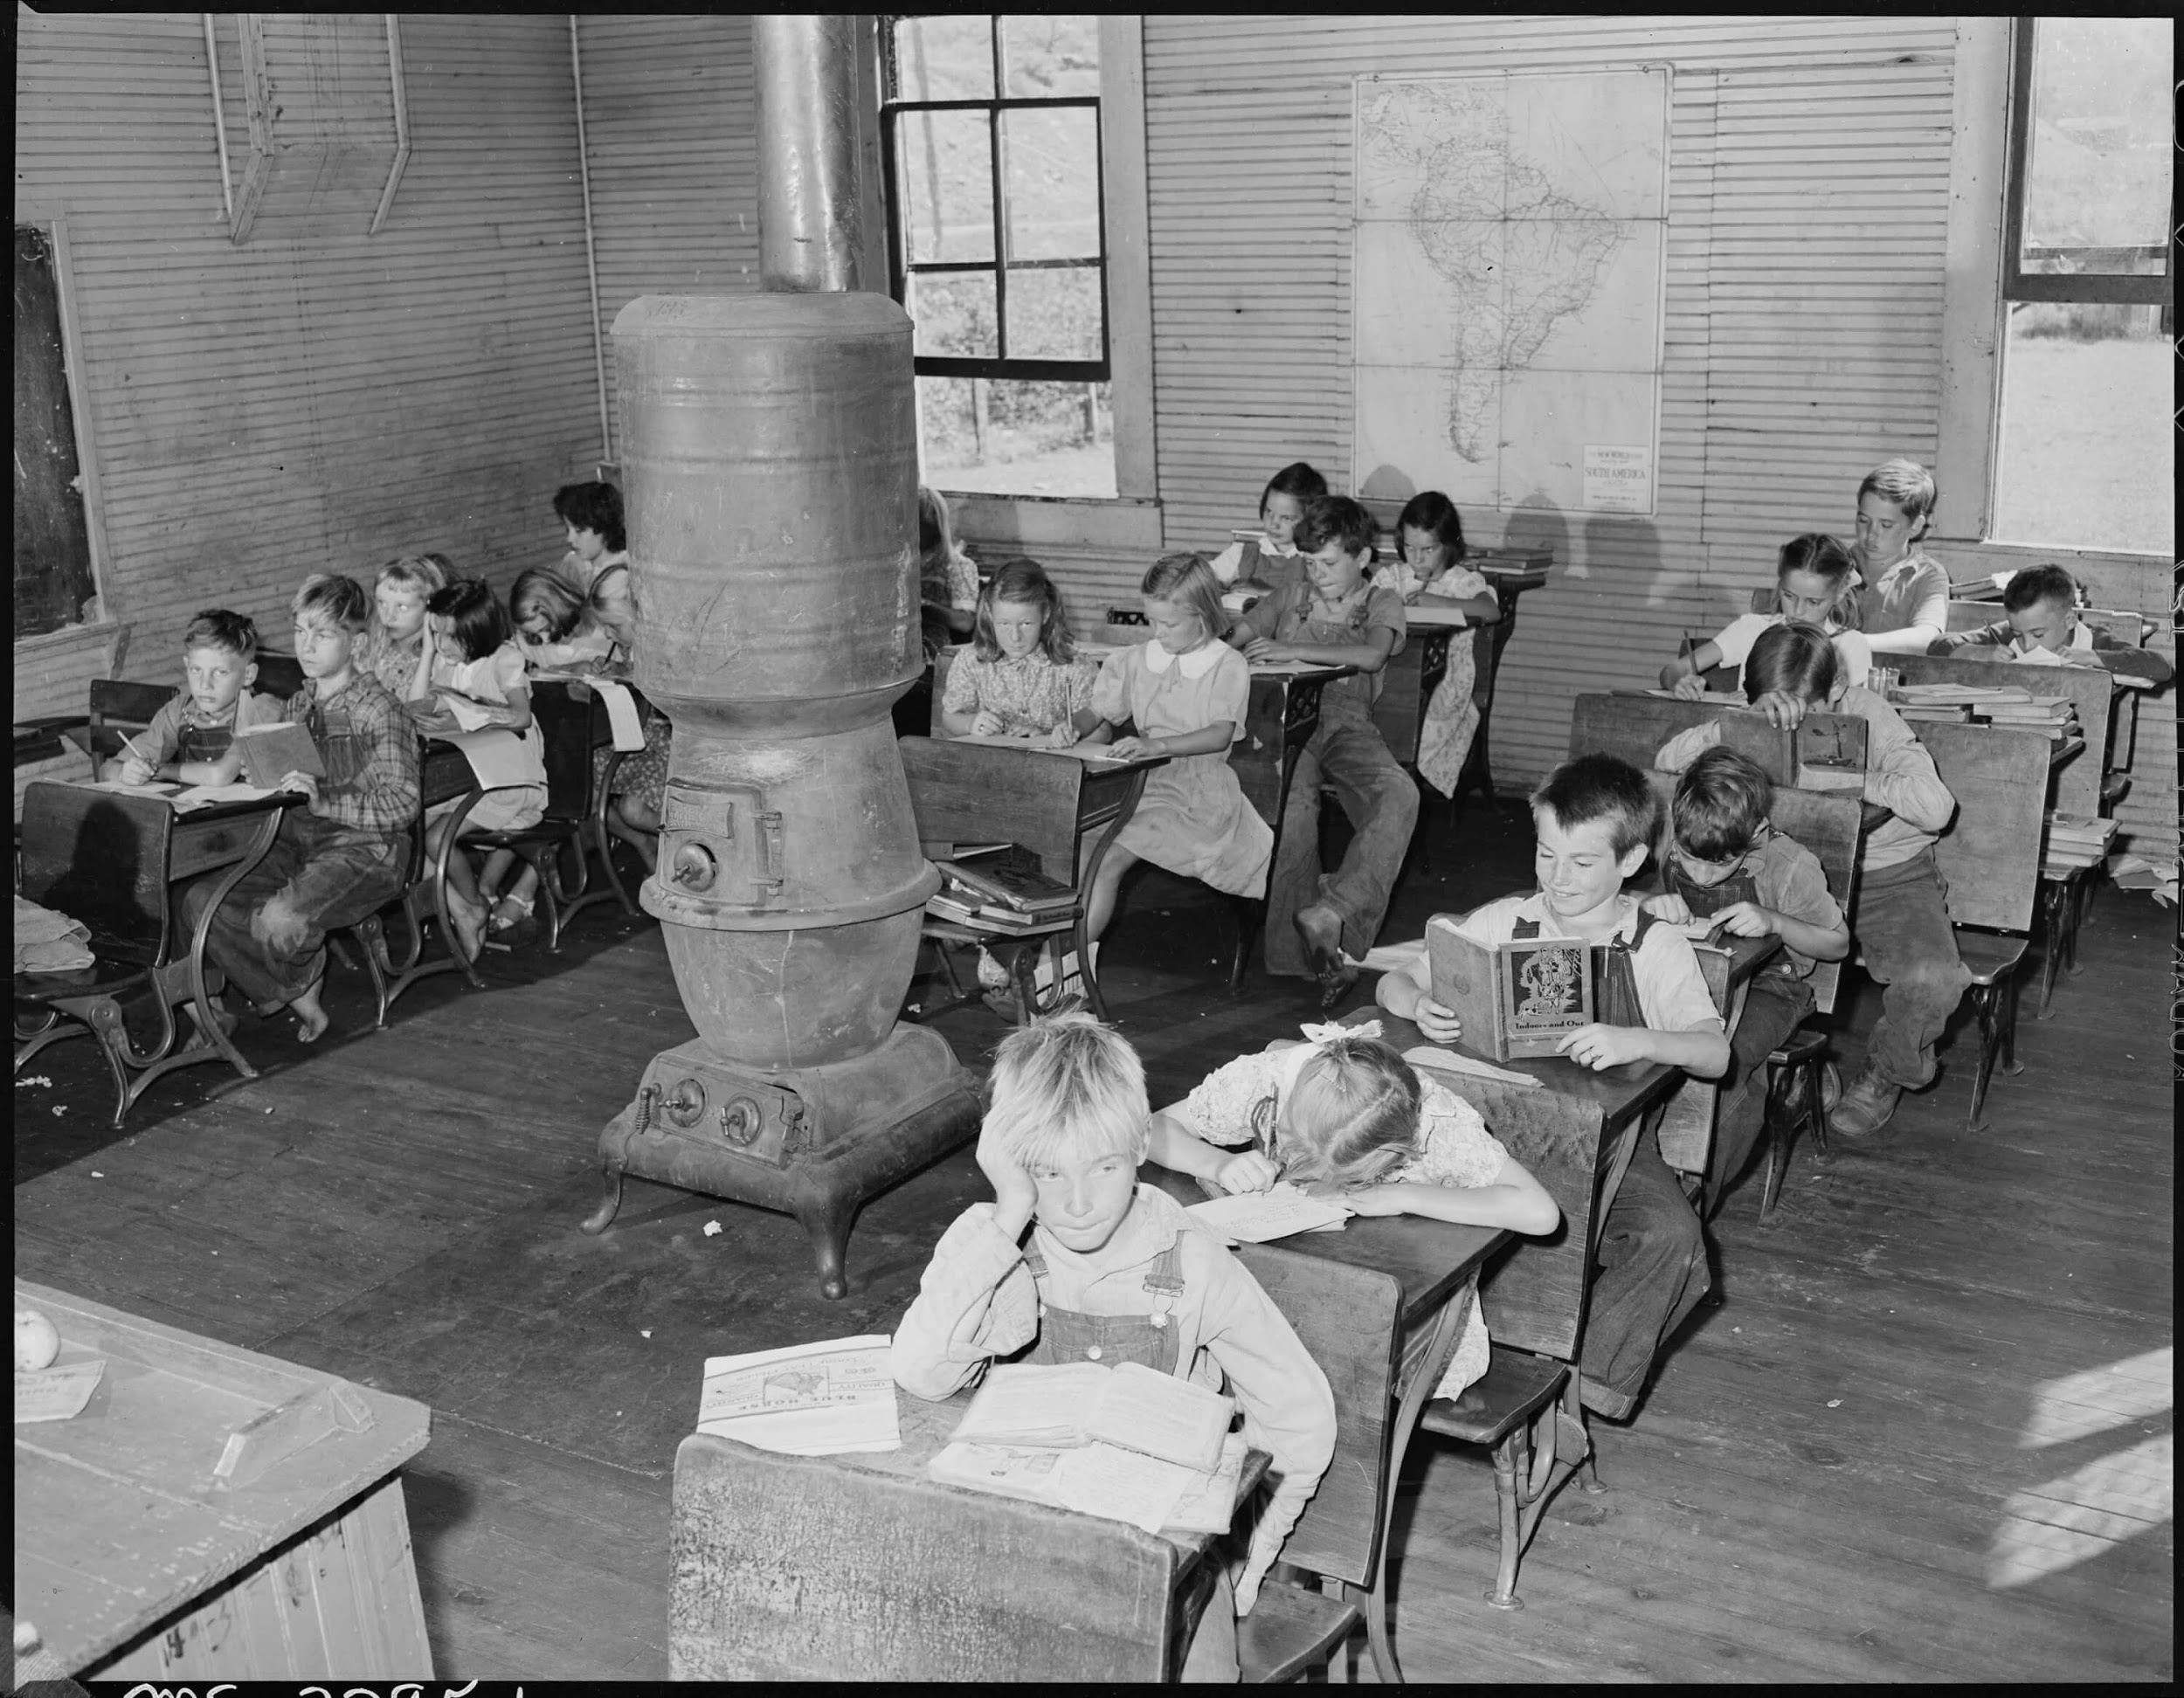
Photo below is from the 1800s
Photo above is from 2017

Slide 5
Let's Not Waste This

